Slide 1
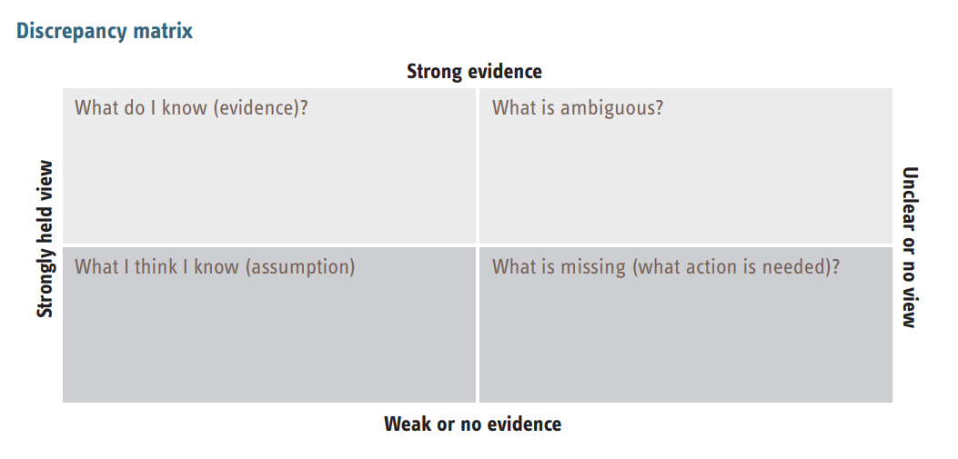
Type the Name of the Child
Type here
Type here
Type here
Type here

